Slide 1


Slide 2



Slide 3

Two clauses of IEEE 730 are dedicated to the planning and execution of the
SQAP:
“Document SQA planning,”
“Execute the SQA Plan.”

Slide 4

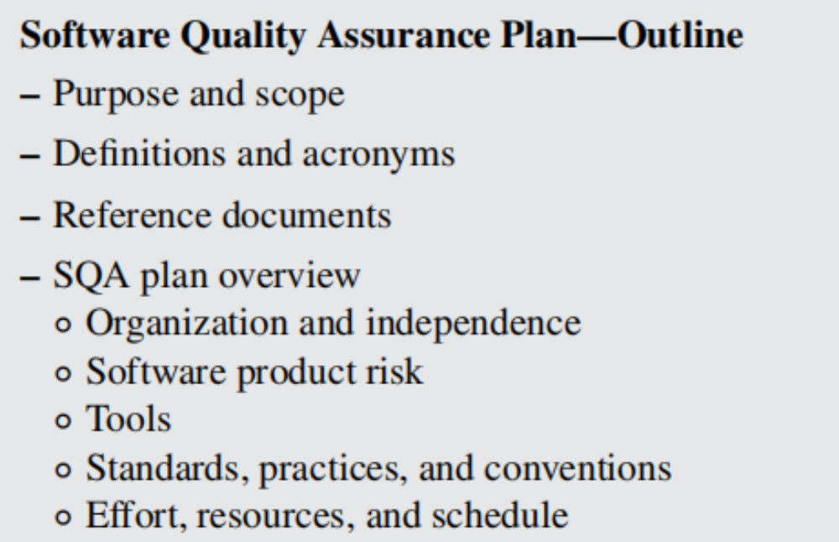

Slide 5
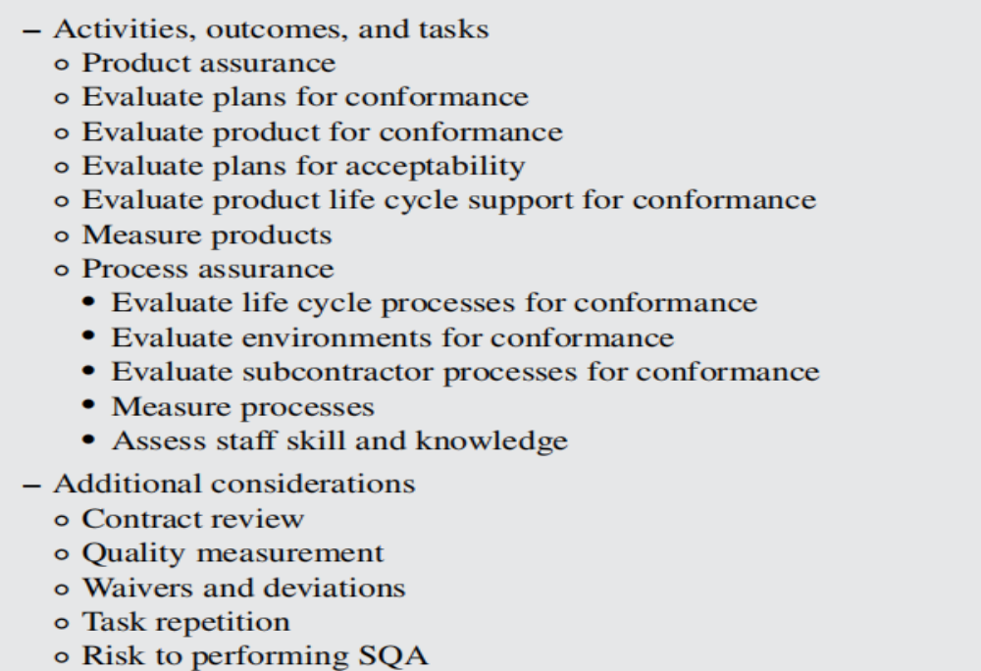
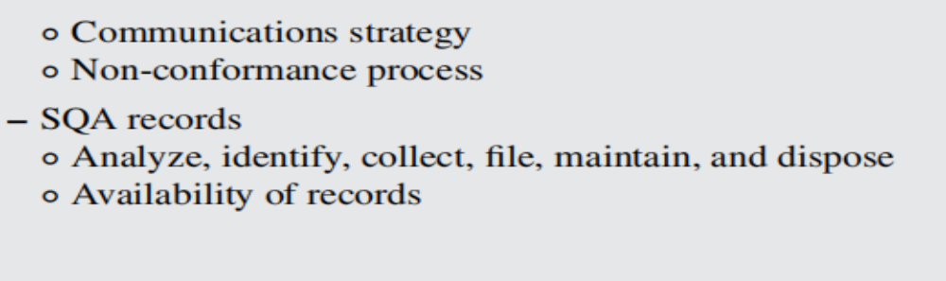

Slide 6
Content of SQAP - Software Quality Assurance Plan¹⁾
1. Purpose
2. Reference documents
3. Management
4. Documentation
5. Standards, practices, convention, and metrics
6. Software Reviews
7. Tests
8. Problem reporting and corrective actions
9. Tools, techniques, and methodologies
10. Media control
11. Supplier control
12. Records collection, maintenance, and retention
13. Training
14. Risk management
15. Glossary
16. SQAP change procedure and history
¹⁾ Underlined sections will be included in our project’s SQAP

Slide 7

Is the project scope clearly defined and well understood?
– Is the SQA role on this project understood by the acquirer, the organization,
the project team and the SQA team?
– Are potential product risks known and well documented?
– Are potential product risks understood so that SQ

Slide 8


Slide 9

What government regulations are applicable to this project?
– What specific standards are applicable to this project?
– What organizational reference documents (such as standard operating pro_x0002_cedures, coding standards, and document templates) are applicable to this
project?
– What project-specific reference documents are applicable to this project?
– Is SQA expected to assess compliance with applicable regulations, standards,
organizational documents, and project reference documents?
– What reference documents are appropriate to include in the SQAP?

Slide 10
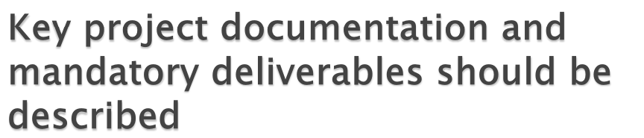
the mandatory project deliverables that will be monitored, reviewed, and autho_x0002_rized during this project;
– where these documents/deliverables can be accessed;
– a reference to existing templates and examples, when available, that will help
participants better understand the expected scope and content to avoid misun_x0002_derstandings;
– identification of the role or individual who will be responsible for creating the
deliverables and authorizing changes once official versions are published and
finalized.

Slide 11
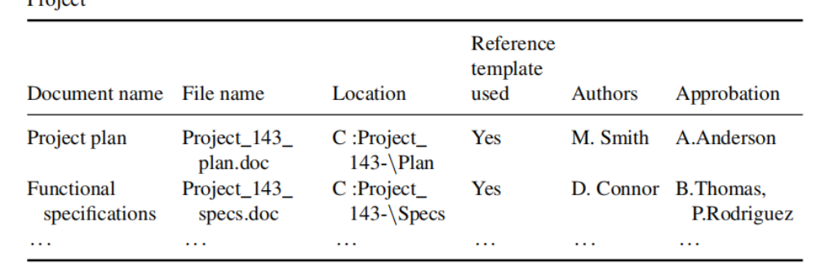

Slide 12

– Have deficiencies in the organization’s SQA policy been identified and
documented?
– Has the project manager established a method for monitoring the execution of
SQA activities, tasks, and outcomes along with a method for providing feed_x0002_back to the independent SQA function (when present)?
– Has the project manager established an effective and appropriate policy defin_x0002_ing and governing SQA roles and responsibilities during the project?
– Has the organization established an independent SQA function with sufficient
influence over software processes, including an effective reporting line inde_x0002_pendent of the software development project?
– Has the organization established responsibility for supervising a project’s SQA
function by an individual independent of both the project manager and the
software development manager?
– Has the organization established a method to enable projects to learn from the
experiences of previous projects, if the SQA function is being established for
more than one project?
– Does the independent SQA review exist independently of SQA processes
established in individual projects?
– Have adequate resources, including sufficient numbers of suitably skilled and
trained people as well as sufficiently capable tools and equipment, been iden_x0002_tified for the project?
– Has the degree of independence (i.e., technical, managerial, and financial) been
defined? (see Figure 13.2)
– Is the defined degree of independence appropriate, given the potential product
risk and the requirements when the project uses external suppliers?

Slide 13
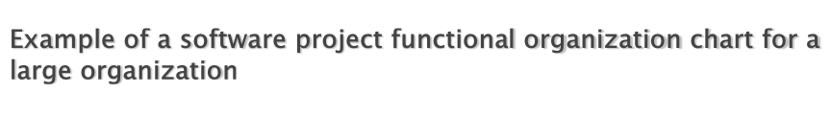
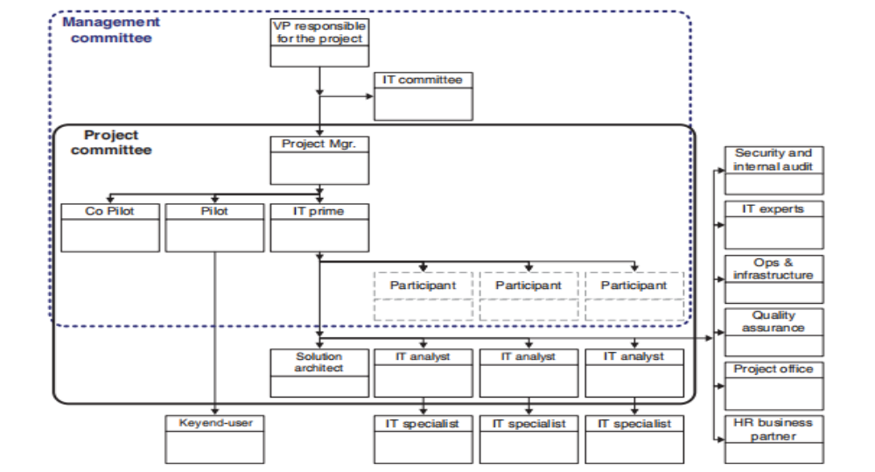

Slide 14
RACI Chart or Matrix
Clarifies roles and responsibilities, making sure that nothing falls through the cracks.
RACI (Responsible, Accountable, Consulted, Informed) charts also eliminate redundant
activities (two or more people working on the exact same thing, without knowing it) and
confusion by assigning clear ownership for each task or decision.

Slide 15
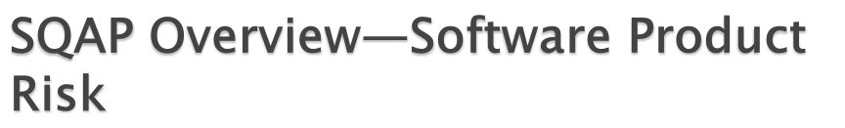
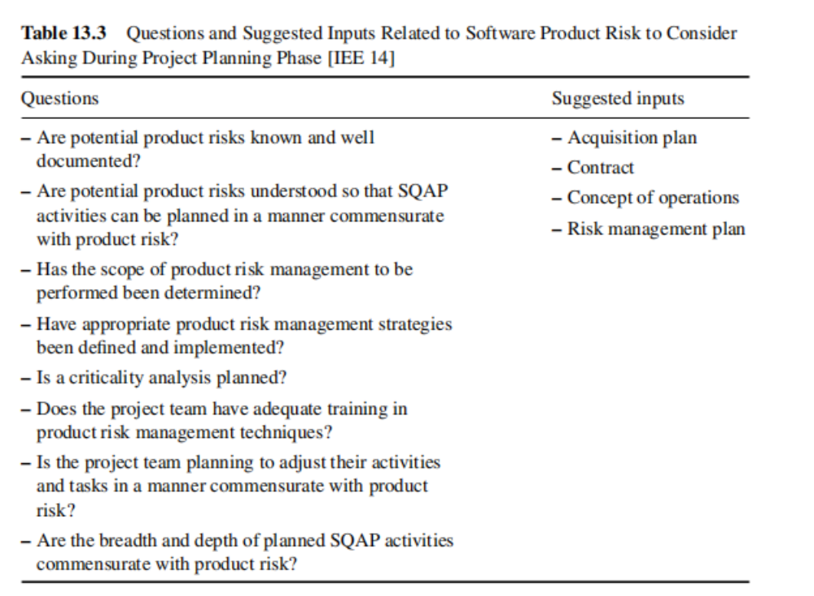

Slide 16

– Have adequate resources, including sufficiently capable tools and equipment,
been identified for the project as well as for other projects if the SQA function
is being established for multiple projects?
– Are all tools planned to be used by SQA on this project completely identified,
including supplier, version or release number, system platform requirements,
tool description, and numbers of concurrent users?
– Based on product risk, do these tools require validation before they can be used
on this project?
– Is training in the effective use of SQA tools required and if so, is training
planned?

Slide 17

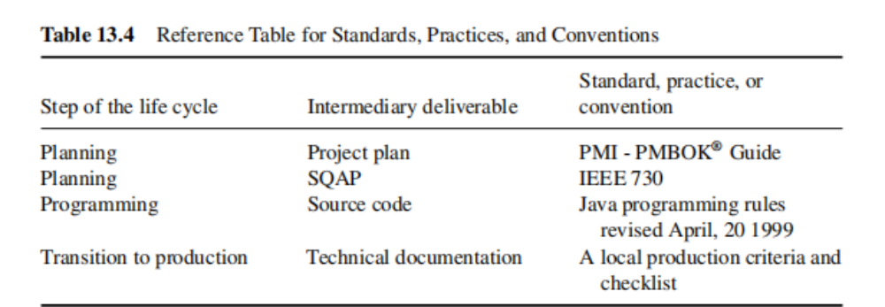

Slide 18

Can estimated effort and schedules be based on past projects?
– Can resource requirements for this project be determined based on past
projects?
– What resources (lab spaces, servers, software, databases, operating systems,
security rights, document control, etc.) are required for this project?
– Is effort based on factual information rather than “gut feel”?
– What estimating and scheduling techniques can be used for this project?

Slide 19
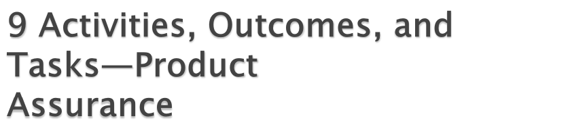
Evaluate life cycle processes for conformance
– Evaluate environments for conformance:
– Evaluate supplier’s processes for conformance:

Slide 20

– Contract review process:
– Quality measurements:
Task repetition:
Risks to performing SQA
Communications strategy:
Document acceptance process
– The review minutes are then signed by all participants
Non-conformance process
In third-party contracts,
Acceptance process:

Slide 21
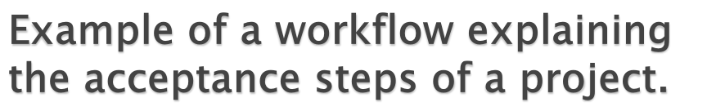
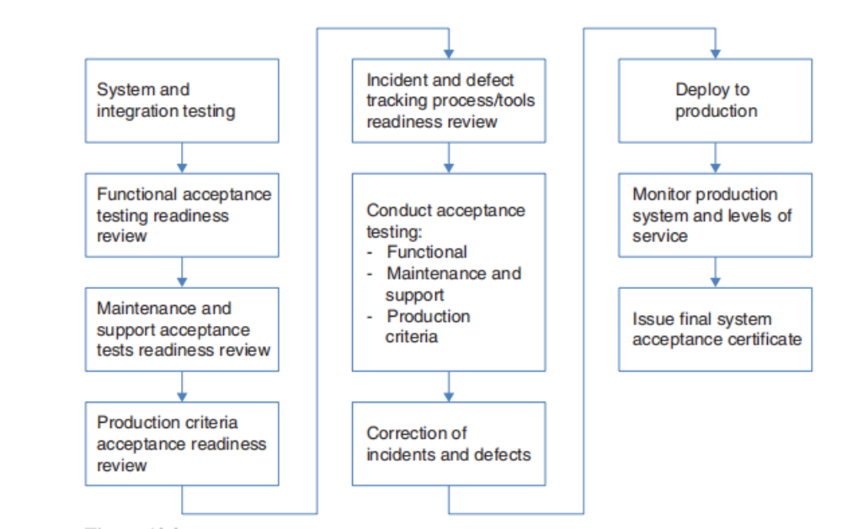

Slide 22

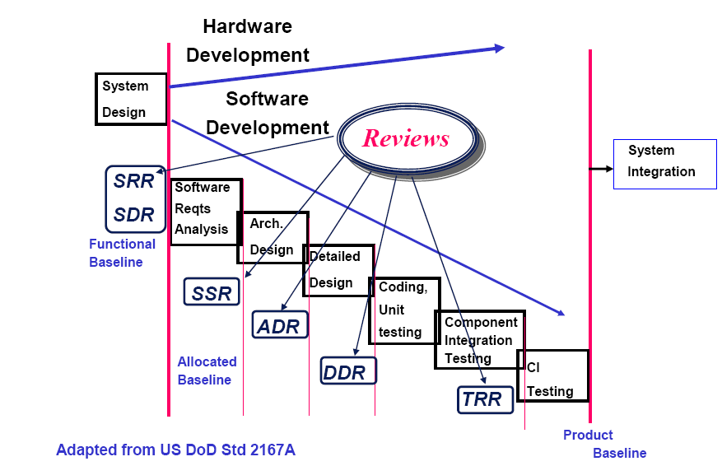

Slide 23
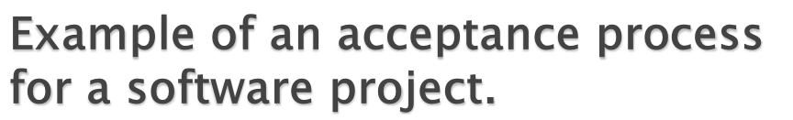
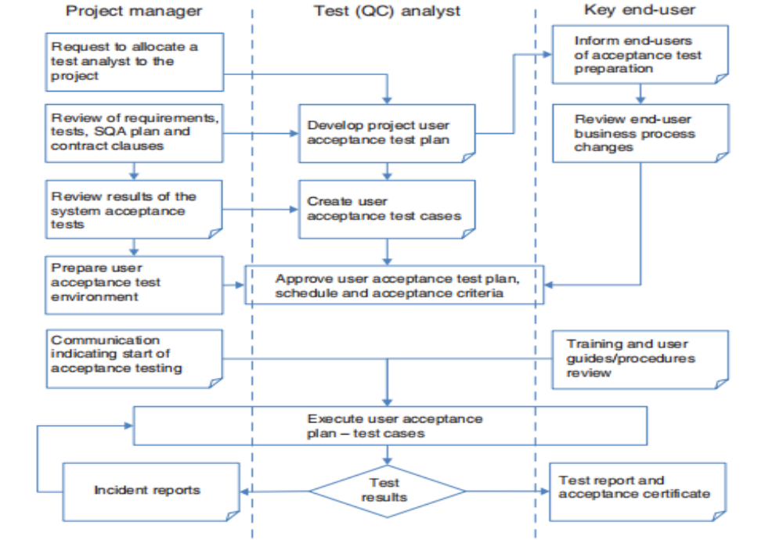

Slide 24

What set of records is the project required to produce?
– What set of records is SQA required to produce?
– Is the information required to be included on each record defined?
– What mechanisms will be used to collect, file, maintain, and eventually dispose
of quality records?
– Who is responsible for collecting, filing, maintaining, and disposing of
records?
– Who is responsible for sharing records?
– What records are to be shared with stakeholders?
– What protections are required to be established in order to share these records,
maintain the integrity of the records, and prevent their modification or inadver_x0002_tent release?
– What records are required from subcontractors?

Slide 25

execute the activities and tasks defined in the SQAP, based on project schedules;
2) create the outcomes identified in the SQAP;
3) revise the SQAP in response to project changes;
4) raise non-conformances when actual outcomes do not agree with expectations

Slide 26
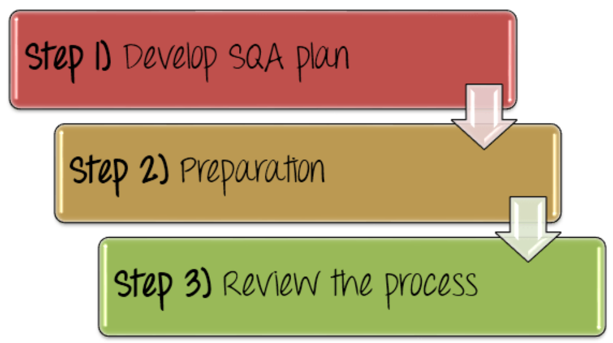

Slide 27
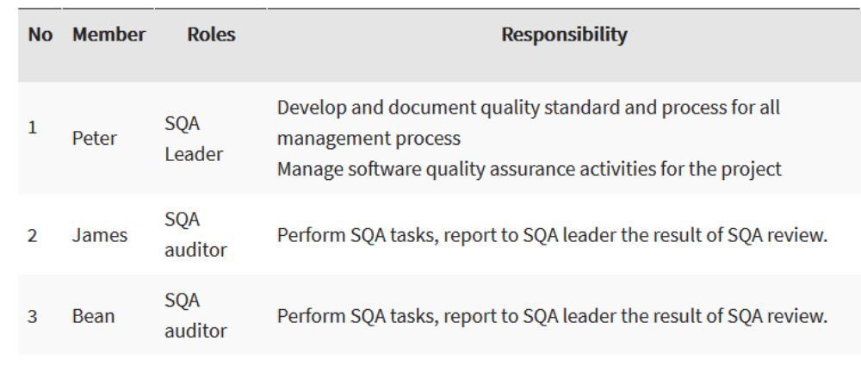

Slide 28
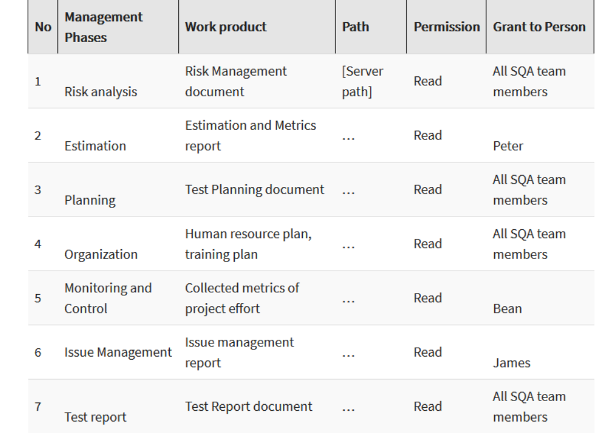
SQA auditor will review and audit

Slide 29
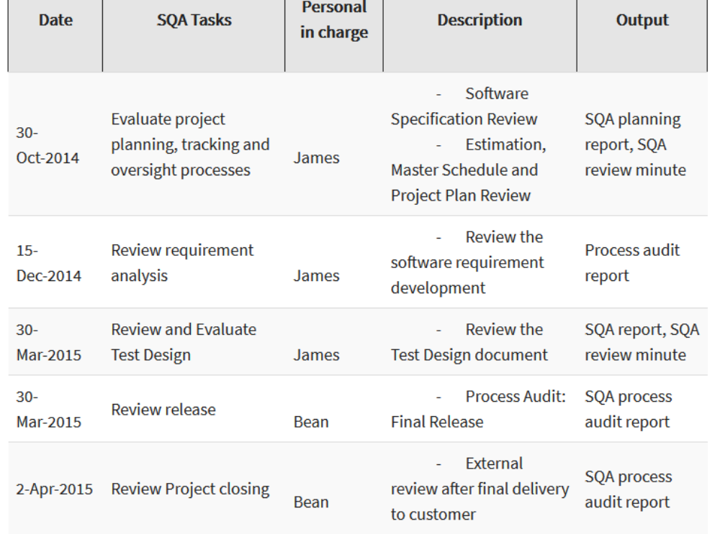
Test Manager makes the schedule for management review

Slide 30
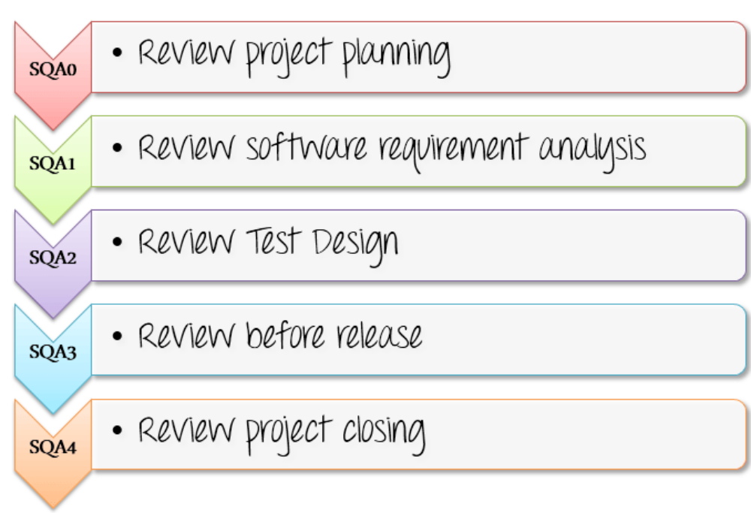
Review the process

